Slide 1

E-Commerce Sentiment Analysis and Customer Behavior Modeling

Slide 2






This presentation is a collaborative effort between
Anupreet
Ashish
Sirisha
Zara
Zena

Slide 3



Introduction
This project aims to leverage machine learning (ML) techniques to analyze customer behaviors using the provided dataset.
We used various analytical and visualization techniques to uncover insights from collected data.
Data would be analyzed to check:
Sentiment analysis to understand customer satisfaction
and
Building a recommendation system to enhance user experience and increase sales.
These objectives align with real-world applications in the e-commerce domain.

Slide 4

Data Sources and Methodology
The project revolves around a detailed dataset, containing information regarding Customers, Customer’s Age, Product Categories, Product Price, Payment Methods etc.
It is a Synthetic dataset collected from Kaggle website and big enough to consider reliable. (more than 500000 rows)

Slide 5
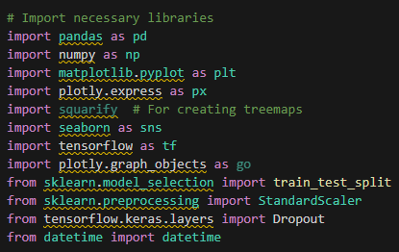








Technologies
This project explores E-Commerce customer behavior trends by analyzing data across multiple variables.
Our team used various analytical and visualization libraries to have an acceptable insights.

Slide 6

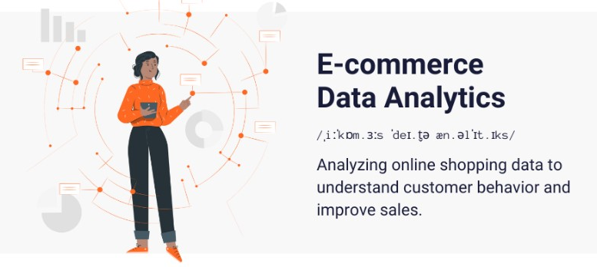
What is E-commerce and E-commerce Analysis
E-commerce is the delivery of information, products, services, or payments by computer, telephone, or other automated media.
Link

Slide 7
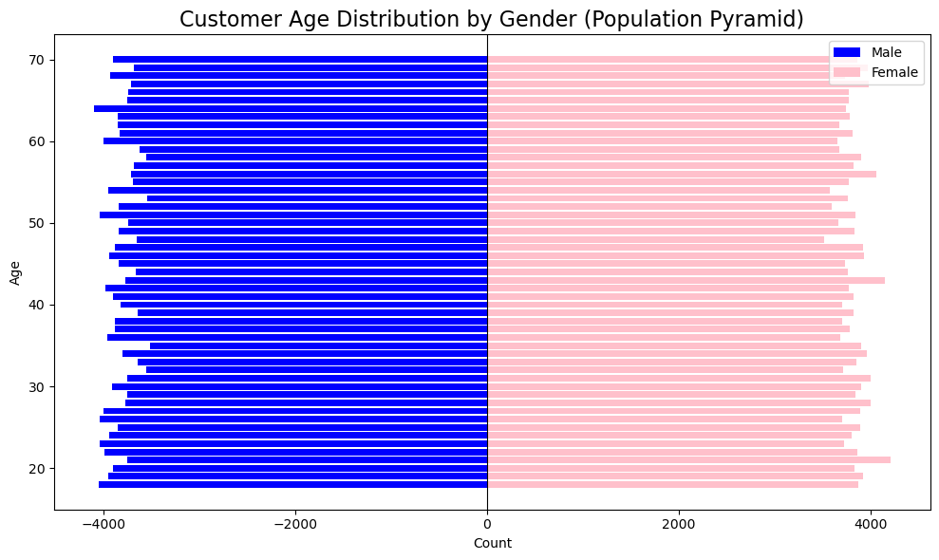
Customer Age Distribution by Gender
Key Observations:
The dataset shows a balanced distribution between male and female customers.
The majority of customers are in the age range of 30 to 50 years, indicating the core demographic for the business.
The distribution is consistent across genders, with slight variations at certain age groups.

Slide 8
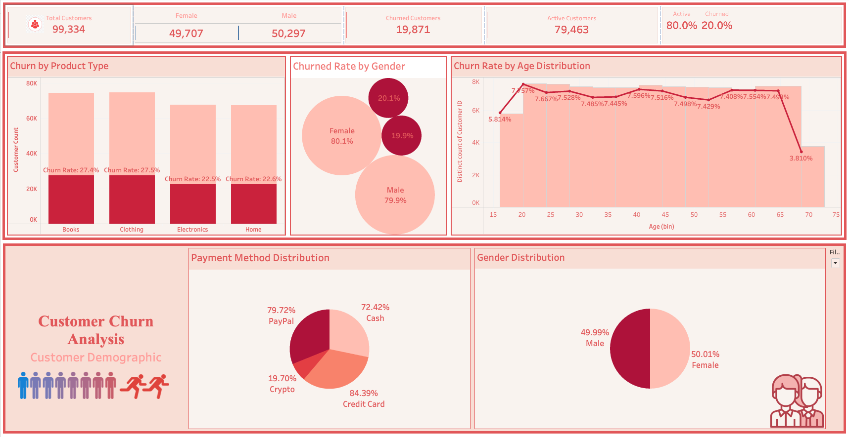
Overview of the visualization
Tableau

Slide 9
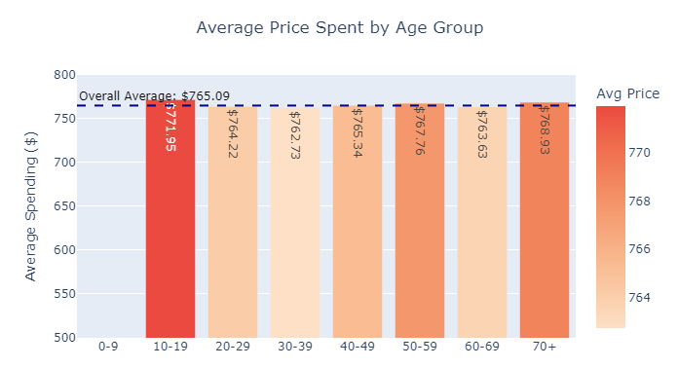
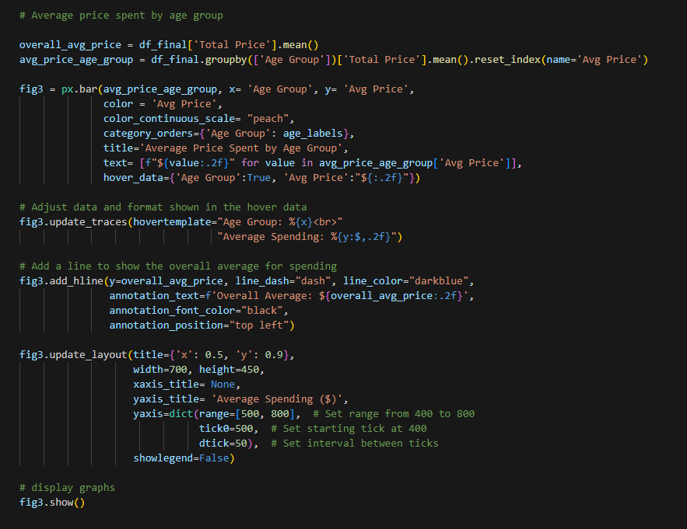
Average Price Spent by Age Group
The intensity of the color (red to light orange) correlates with the average spending amount.

Slide 10
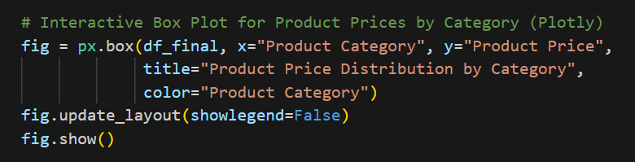
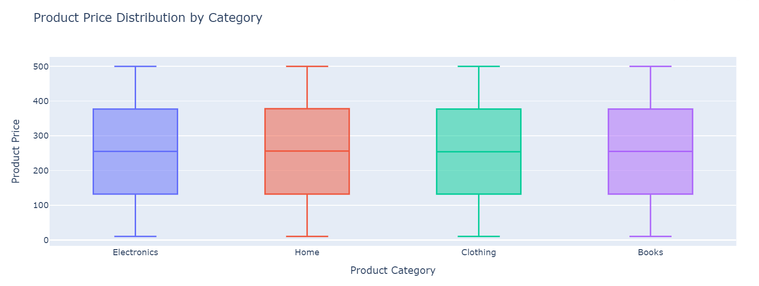
Product Price Distribution by Category

Slide 11
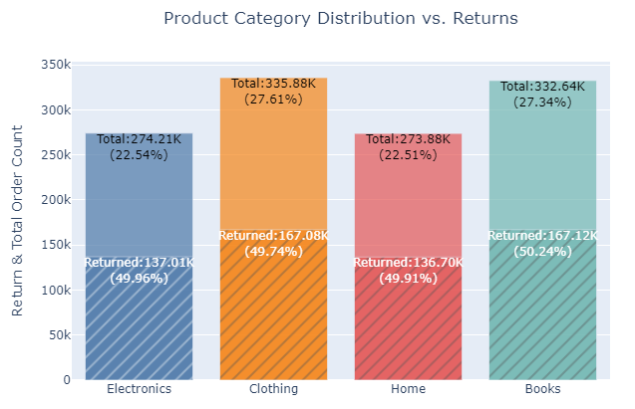
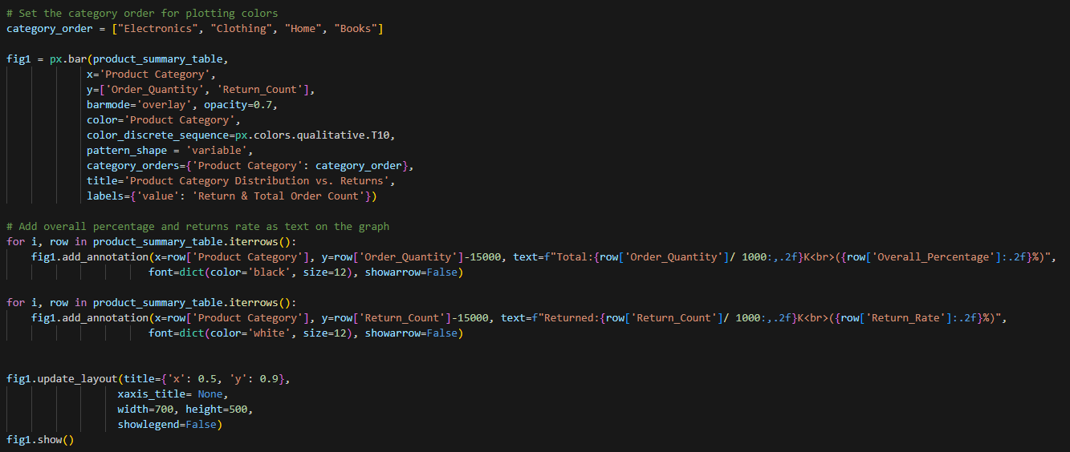
Product Category Distribution vs. Returns

Slide 12
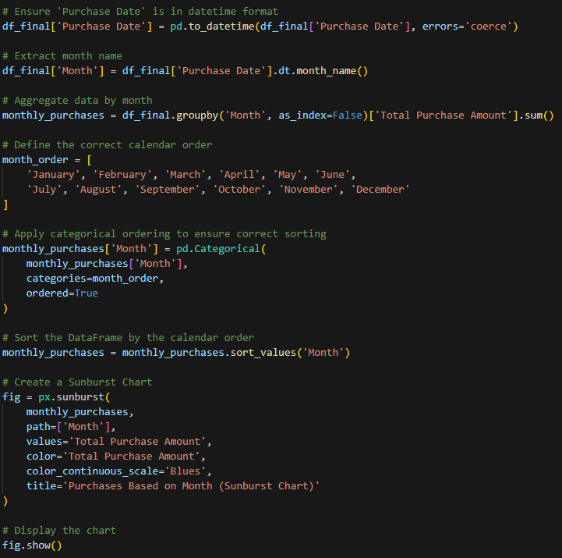
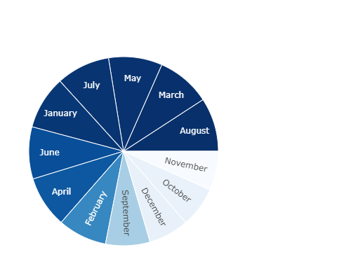
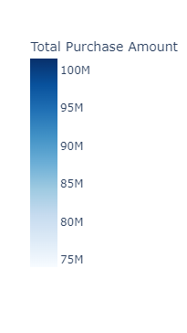
Purchases Based on Month

Slide 13


Customer Retention VS Customer Churn
E-commerce churn is the number of customers who stop buying from an online store
Customer retention is a company's ability to keep customers as repeat buyers and prevent them from switching to a competitor.

Slide 14
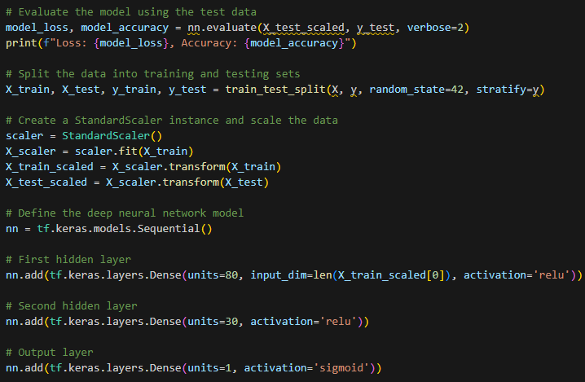
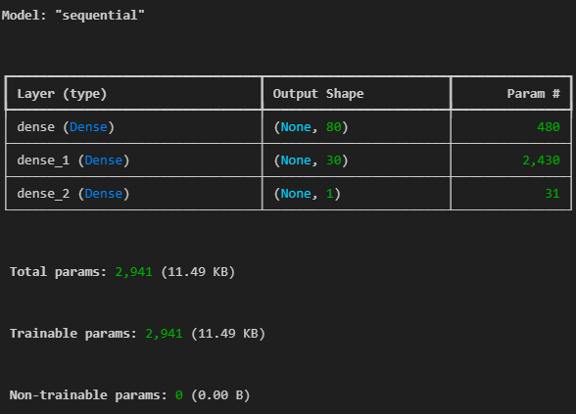
Different Types of Modeling- Churn
Deep Neural Network (DNN)
Model for binary classification, specifically predicting churn (whether a customer will leave or stay active).

Slide 15
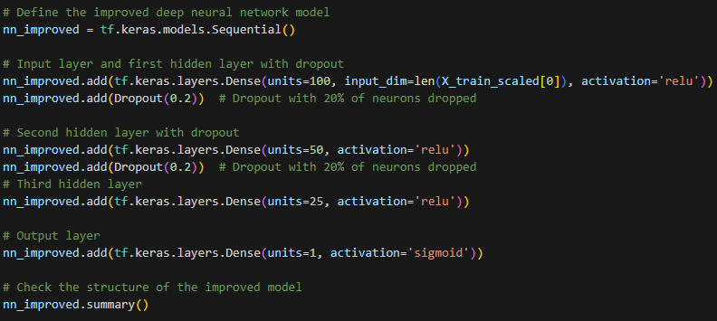
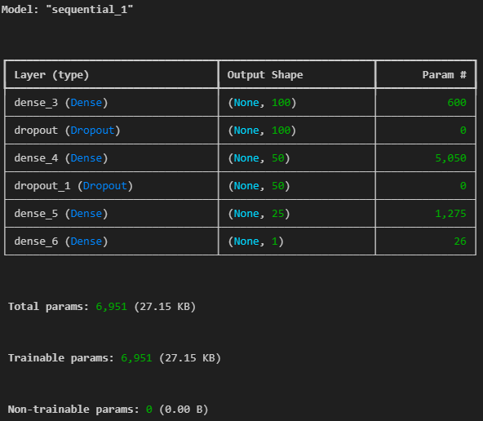
Improving the Modeling

Slide 16
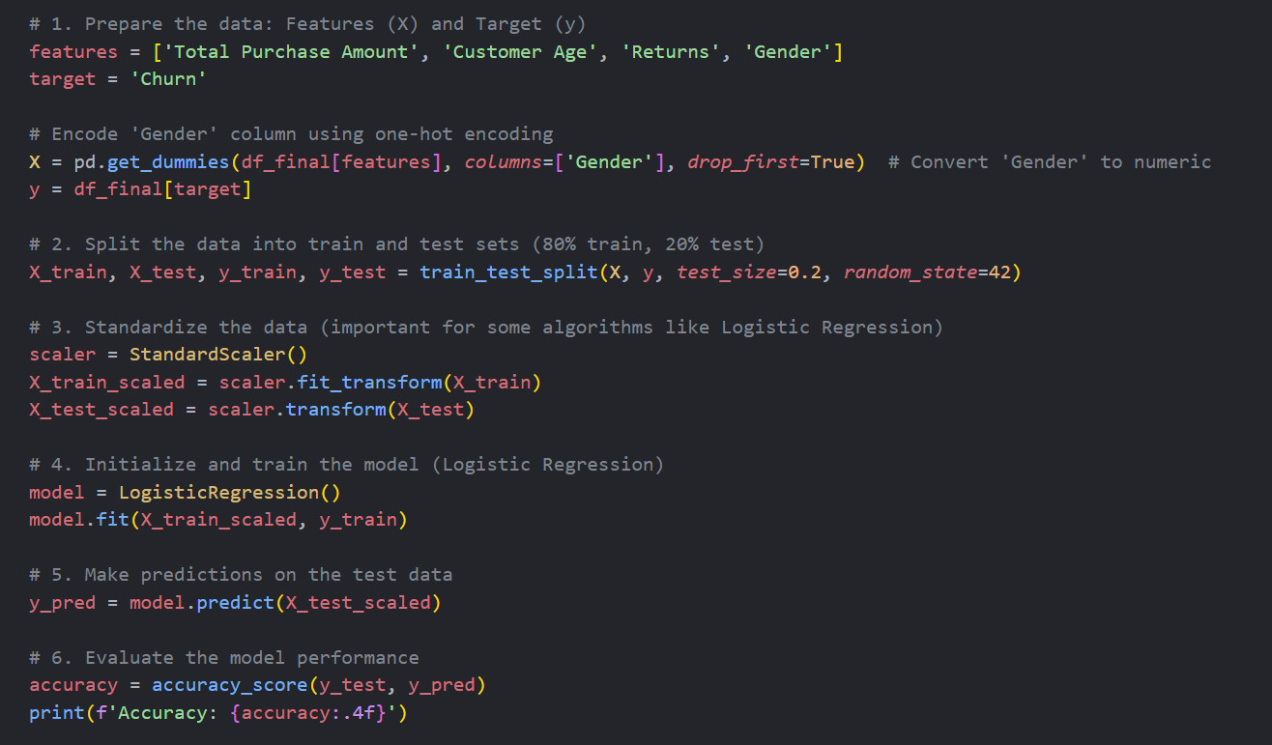
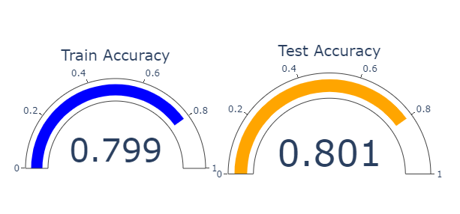
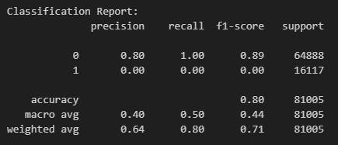
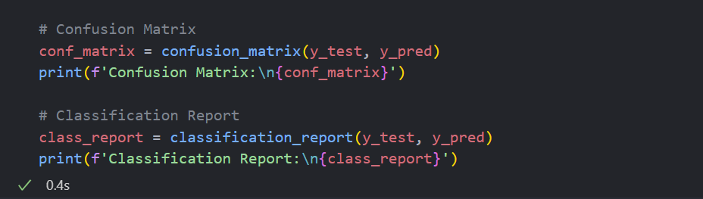
Different Types of Modeling- Churn
Logistic Regression
Model that is a widely used linear classification.
It predicts the likelihood of a binary outcome.

Slide 17
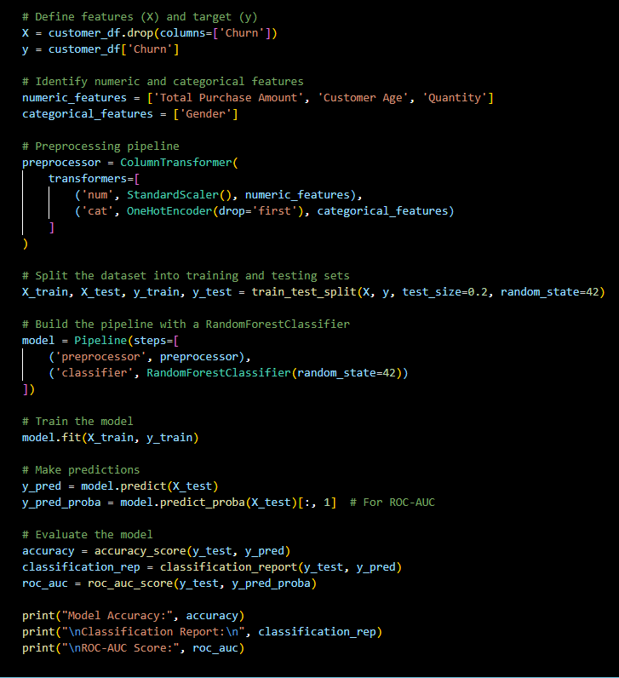
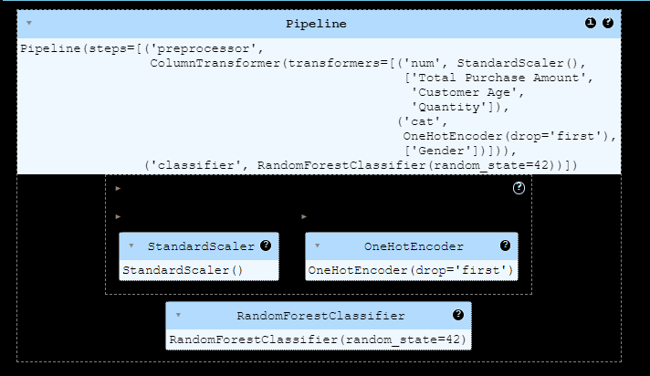
Different Types of Modeling- Churn
Random Forest Classifier
Supervised machine learning algorithm used for binary classification tasks, where the goal is to predict one of two possible outcomes.

Slide 18
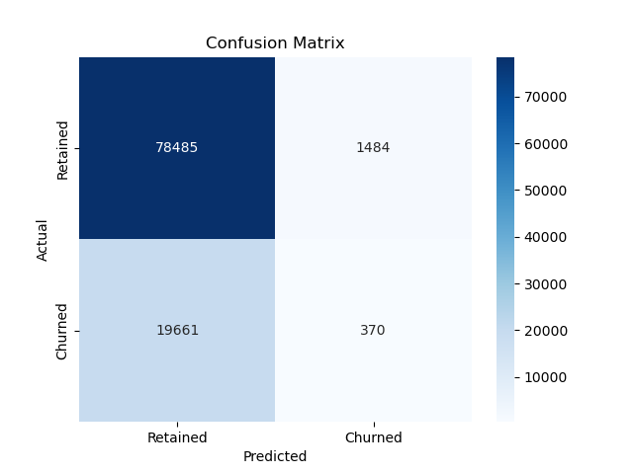
Confusion Matrix
Evaluates a classification model's performance
Retained (TN): 78,485 customers correctly predicted as retained.
Churned (FN): 19,661 customers incorrectly predicted as retained.
Churned (TP): 370 customers correctly predicted as churned.
Retained (FP): 1,484 customers incorrectly predicted as churned.
The model predicts retained customers well but struggles to identify churned customers, suggesting class imbalance or low sensitivity (recall).

Slide 19
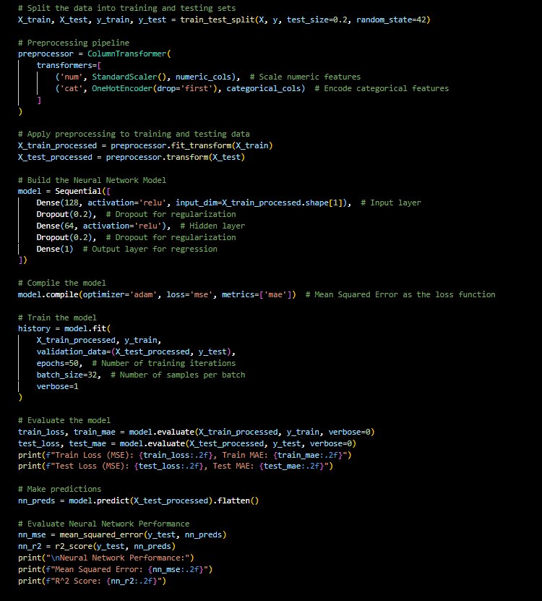
Modeling to predict- Revenue
Deep Neural Network (DNN)
Regression by preprocessing the data (scaling numerical and encoding categorical features).
Splitting it into training and testing sets, training the model with mean squared error (MSE) as the loss function.
It evaluates the model's performance using metrics like MSE, MAE, and R² score on both training and test data.

Slide 20
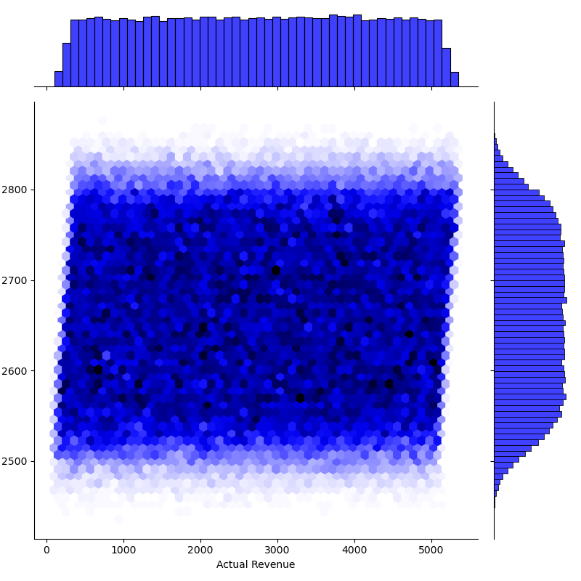
Reality VS Predict
Hexbin Plot
What it shows:
This is a hexbin plot comparing actual revenue (x-axis) to predicted revenue (y-axis).
Each hexagonal bin represents a region of density, with darker shades indicating a higher concentration of data points.
Key Insights:
The plot shows most of the predictions are clustered within a narrow range, especially along specific values for predicted revenue.
The model seems to lack variability in predictions, as the predicted values are concentrated regardless of the actual revenue.

Slide 21
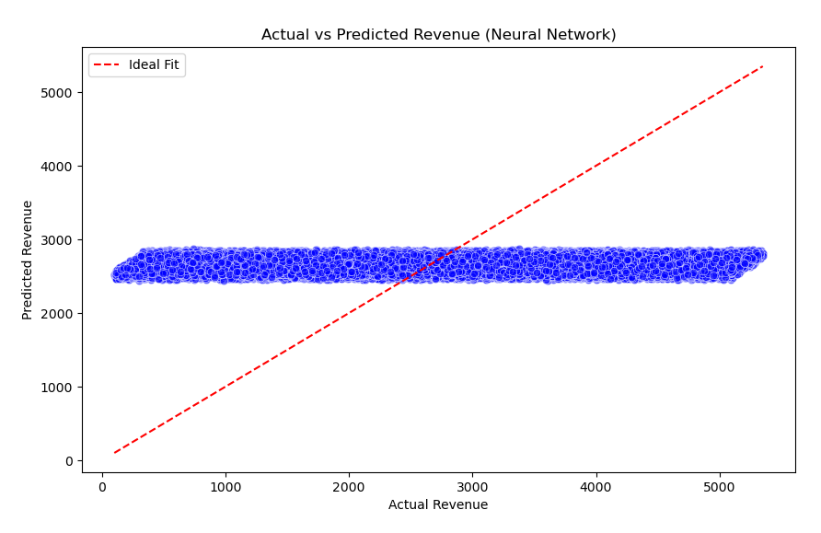
Reality VS Predict
Scatter Plot with Ideal Fit
What it shows:
This scatter plot compares actual revenue (x-axis) with predicted revenue (y-axis), overlaid with a red ideal fit line (diagonal line where predictions = actual values).
The ideal fit represents perfect predictions, where every data point would lie directly on the line.
Key Insights:
Most predicted values fall far from the ideal line and are concentrated within a narrow band, indicating the model is poorly capturing the true variance in actual revenue.
The gap between the scattered points and the red line suggests a significant lack of accuracy in predictions.

Slide 22
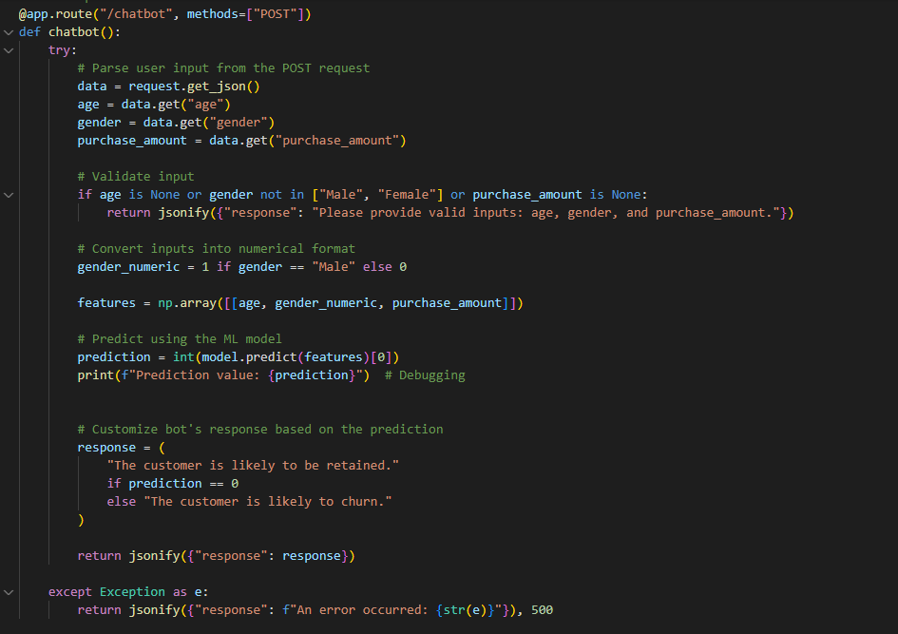

Predictionbot!!!
Defines a Flask API endpoint for predicting customer churn. It parses user input, validates it, converts the data into a numerical format, makes a prediction using a trained machine learning model, and returns a response indicating whether the customer is likely to churn or be retained.

Slide 23

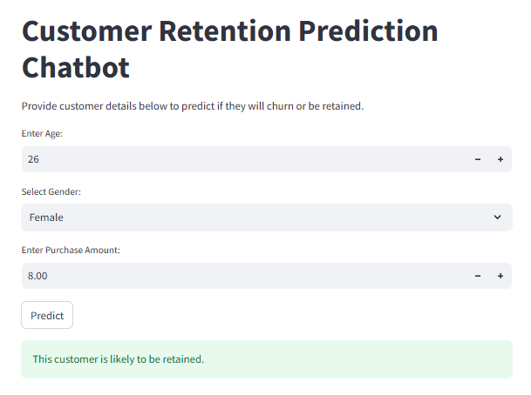
Let me Guess!

Slide 24

Any Questions
Thank You!

